Slide 1

Project Report
Submitted to Submitted by
Ashok Maurya Karan Singh Parihar
GM(S&T) B.Tech JECRC

Slide 2
Acknowledgement
The work on this project was conducted as a part of my summer training during June 2018. Appreciation is expressed to the members who served as the Technical Advisors for their input and assistance. A special gratitude to Mr. Anil Kumar, without whom the training would not have been made possible. Appreciation is also acknowledged to Jaipur Metro Rail Corporation Ltd. For allocating their resources and technical support.

Slide 3
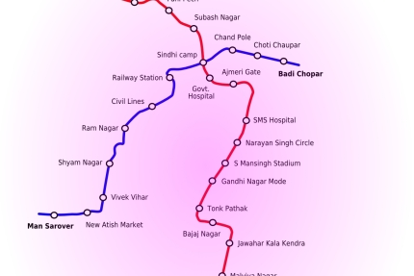
Map Of Jaipur Metro

Slide 4
Telecommunication

Slide 5
CONTENTS
FIBRE OPTIC TRANSMISSION SYSTEM (FOTS)
TELEPHONE SYSTEM (EPABX)
TRAIN RADIO SYSTEM
PUBLIC ADDRESS SYSTEM (PAS)
PASSENGER INFORMATION DISPLAY SYSTEM (PIDS)
MASTER CLOCK
CLOSED CIRCUIT TELEVISION SYSTEM
MAN MACHINE INTERFACE (MMI)
POWER SUPPLY SYSTEM

Slide 6
FIBRE OPTIC TRANSMISSION SYSTEM
The FOTS shall provide a transmission network of voice, data and video signals between all stations, depot and OCC with sufficient transmission bandwidth to cater for the JMRC operational needs.
The FOTS shall provide a common transmission backbone for the telecommunication sub-systems and other systems.
The FOTS shall consist of the following functional parts:
A single mode optical fibre cable network as per cable specifications;
Digital transmission equipment connected to the single mode optical fibre optic transmission network.
Major equipment shall include SDH equipment’s with Ethernet over SDH technology.
Network management systems at OCC to monitor the status of the FOTS equipment and control the operation.

Slide 7
Telephone System
Telephone system shall provide a digital EPABX based fixed telephone network. It shall also encompass a direct line telephone communication system to provide direct telephone lines for train operation, traction power supply control and maintenance telephone lines for track Rolling Stock, Signalling and Telecommunication. The telephone system shall ensure instant and un-interruptible communication between key locations.
Telephone sub-system shall consist of following sub-systems-
EPABX Network
Direct Line Telephone Communication
Network Management System

Slide 8
EPABX Network
EPABX stands for Electronic Private Automatic Branch Exchange.
It does not require any operator or attendant at the switch board to establish connections between the central office trunks and stations, or between stations.
Here every station is linked by two cables so that if any fault occurs in one of them, either can serve the purpose.
Inside a station they are connected through twisted pair cable while between stations it is connected through FOTS.
In digital communications, where a single physical wire pair can be used to carry many simultaneous voice conversations by time division multiplexing. ’E1’ is standard E-Carrier system.

Slide 9
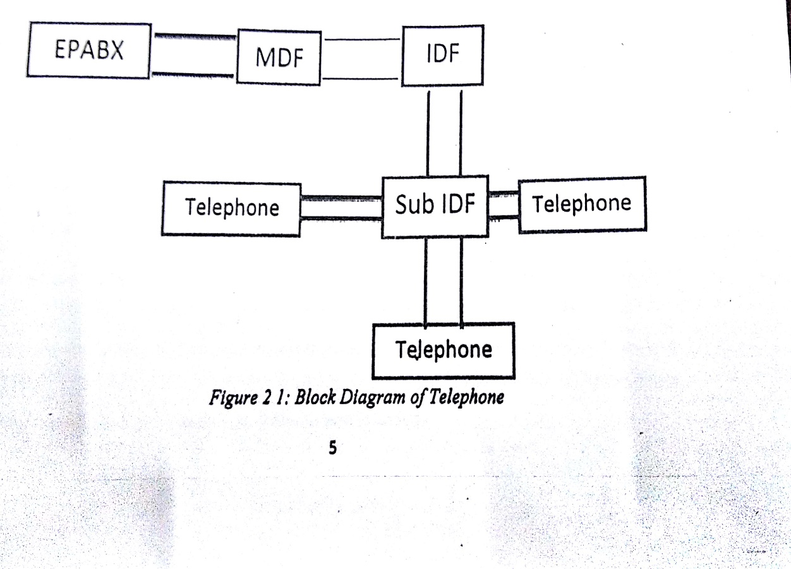
EPABX Network ...
An E1 link operates over two separate sets of wires, usually unshielded twisted pair(balanced cable) or using coaxial cable(unbalanced cable). A nominal 3V peak signal is encoded with pulses using a method avoiding long periods without polarity change. The line data rate is 2.048 Mbps which is split into 32 time slots each being allocated 8 bits in turn. Thus each time slot sends and receive an 8-bit PCM signal.

Slide 10
Direct Line Telephone Communication
The direct line telephone communication system shall provide control telephone lines for track operation, traction power supply control and maintenance telephone lines for track, rolling stock, signalling and telecommunications. The system shall ensure instant, un-interruptible communication between key points, which shall include the following-
Between OCC and different key locations like all Station Control Rooms (SCR),Depot Control Centre (DCC),Traction Sub Stations(TSS),Receiving Sub Station (RSS), Auxiliary Sub Station (ASS), Each signalling equipment room and telecommunication equipment room at Stations and Depots and emergency telephones in the tunnels.
Between adjacent and interfacing Station Control Rooms.

Slide 11
Direct Line Telephone Communication
Between adjacent and interfacing interlocked Station Control Rooms.
Between adjacent interlocked Station Control Rooms and DCC.
For emergency communication at locations close to the cross passengers in the tunnels.
Between OCC and Police, Fire services through leased PSTN Telephone lines, if any.

Slide 12
Network Management System
The Telephone Network including EPABX and Direct line Telephone Communication System shall be monitored, supervised and controlled by a Network Management System.
All Equipment's of Telephone System are powered 48V DC.

Slide 13
TRAIN RADIO SYSTEM
The Train Radio System shall comprise the following main functional elements:
Train Radio to OCC and vice-versa.
Hand Portable Phone to OCC and vice versa.
Hand Portable Phone to DCC and vice-versa.
Hand Portable Phone to Hand Portable Phone .
SCR to OCC and Hand Portable Phone /Train Mobiles and vice-versa.
Distress call between the train-borne mobile and Hand Portable Phone as well as between Hand Portable Phones.

Slide 14
Terrestrial Trunked Radio (TETRA)
TETRA is a professional mobile radio and two-way trans-receiver specification.
TETRA uses Time Division Multiplexing (TDMA) with 4 user channels on radio carrier and 25 KHz spacing between carriers.
A frequency range of 380-420 MHz is used.
Types of users –
Hand Portable
Train Radio
Radio Console Workstation
Zetron

Slide 15
Terrestrial Trunked Radio (TETRA)
Base Station is installed on every station with range divided into bands of 10MHz.
Modulation used is pi/4-QPSK.
Both group call and private call features are available.
The components of base radio are:
Power Supply (48V DC)
Base Radio Controller
Transmitter
Receiver
Power Amplifier (75W)
TETRA site controllers(2) – provide channels.

Slide 16
PUBLIC ADRESS SYSTEM
PAS are used for making announcements on the concourse as well as platforms.
A public address system is an electronic sound amplification and distribution system with a microphone amplifier and loudspeakers.
It is divided into three parts:
Control Equipment
Speakers
Ambient Noise Sensors (ANS).
It works on 230V AC Supply.
There are 4 zones of a station namely platform 1, platform 2, concourse, technical room, therefore 2 power amplifiers are allotted for each zone.

Slide 17
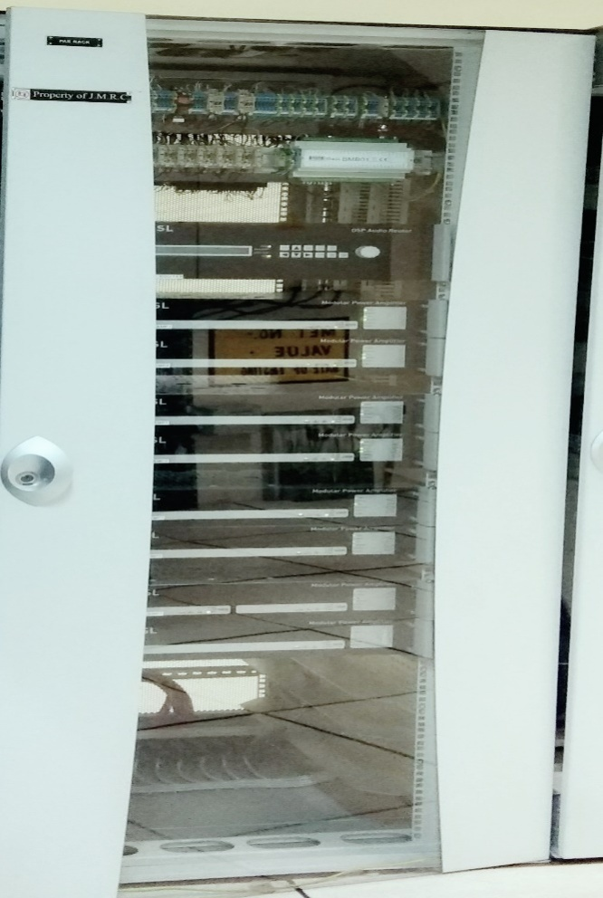
PUBLIC ADRESS SYSTEM
DSP Router has a fully digital signal path consisting of 12 inputs and 12 outputs.
There are 8 ANS on a station, 2 in each zone. The purpose of ANS is to measure the level of noise and sends to DSP Router which sets the level of Power Amplifiers accordingly.
There are 3 types of speakers used –
28 speakers on each platform → Type CELL 10/TC
55 speakers on concourse → Type MWC 6/T
45 speakers on depot. → Type PH 30TC\
There are 3 types of microphone used –
SMC: Station Control Master
DM 505
SM 503

Slide 18
PASSENGER INFORMATION DISPLAY SYSTEM
PIDS will be triggered by Train Control and Signalling System (TC&S) and shall automatically provide real time visual information about train arrival/ departure throughout the station. PIDS shall enable the operator in SCR/OCC to display routine and special emergency messages for passengers and staff in stations and in concourse at intermediate and end terminal stations and interchange stations.
There are 2 PIDS installed on concourse and 2 PIDS in each platform. These PIDS are LED screens and display first three arriving trains.
The control equipment is placed inside TER.

Slide 19
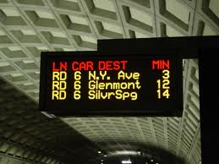
Functioning of PIDS
There are 2 racks, one in OCC and other in TER room.
The information comes from ATS server which is connected than to the switch, which forwards it to the router of LAN through SDH.
This information is transferred to TER rack switch which records the information displayed as well as provides it to media converter, which records the information displayed as well as provides it to media converter, which converts the light into electrical signals.
ODF : Optical Distribution Frame which interfaces with LED array.

Slide 20
MASTER CLOCK
The clock system shall be based on the principal of master, sub-master and slave clocks working mechanism. Master clock shall be installed at the OCC and shall be capable to drive number of sub-master clocks as per requirements.
The master clock is built around Global Positioning System (GPS) receiver and shall be self-correcting in the event that the synchronization GPS signal is lost temporary and re-established. In the absence of GPS, the receiver shall operate in free running mode with an internal clock supplying the time signals.
The master clock is capable of receiving Universal Co-ordinated Time (UTC) data from GPS satellite, decoding and verifying it and passing the data forward to slave clock.

Slide 21
Functions of Master Clock System
Provide the master clock source for equipment synchronization.
Provide the master reference date and time information.
Provide the reference clock signals for station clock displays.
Distribute the master clock source and reference date and time information to OCC, Stations and Depot.

Slide 22
CLOSED CIRCUIT TELEVISION SYSTEM
CCTV system shall be provided for real time, colour visual surveillance through colour display of all public and selected areas. It is supervised locally from SCR & OCC. CCTV shall also cover as a minimum all curved platform on the metro corridor in the normal direction of travel, to provide train drivers with a clear, un-obstructed view of the entire length of the train from the driving cab.
There are 2 types of CCTV cameras – fixed and dome type.
Fixed type requires twisted pair LAN cable.
Dome type requires LAN Cable as well as power cable for rotation.
Distribution of cameras:
Platform – 14 cameras (13 fixed, 1 dome)
Concourse – 27 cameras (24 fixed, 3 domes)

Slide 23
CLOSED CIRCUIT TELEVISION SYSTEM
The rack of CCTV in TER is as follows –
The switch acts as a router (called Layer-3)
RAID (Redundant Array of Inexpensive Disks)
Data is distributed across the drives in one several ways referred to as RAID levels. The different schemes are named by the word RAID followed by a number.
CCTV requires a single phase 230V AC supply to operate.

Slide 24
Man Machine Interface
All MMI shall be designed taking in to consideration the risk of repetitive strain injury, eye strain and radiation induced illness to staff operating such interfaces.
All MMI for the staff to operate, control, monitor and maintain the system shall be user friendly, be of consistent design and shall adopt similar convention across all the subsystems.

Slide 25
MMI Used on the Radio System
Radio Control Workstation (RCW): RCW shall have full dispatcher facilities for controllers through the use of feature rich GUI.
Radio Access Unit (RAU): The RAU shall provide all individual and group call set up and receipt through the use of a multi-function feature phone facility connected directly to the Radio Control System.
Radio Control Panel (RCU): The RCP shall be located at station control rooms and other designated locations and provide full fixed and mobile Radio functions including individual and multi-group calls.
Train Radio Control Panel (TRCP): The TRCP shall be integrated into the train cab and shall provide train drivers with all call functions via the Radio control head.
Hand Portables.

Slide 26
UNINTERRUPTED POWER SUPPLY
An uninterruptible power supply, also uninterruptible power source, UPS or battery/flywheel backup, is an electrical apparatus that provides emergency power to a load when the input power source or mains power fails. A UPS differs from an auxiliary or emergency power system or standby generator in that it will provide near-instantaneous protection from input power interruptions, by supplying energy stored in batteries, super capacitors, or flywheels. The on-battery runtime of most uninterruptible power sources is relatively short (only a few minutes) but sufficient to start a standby power source or properly shut down the protected equipment.
There are 2 UPS here which work in parallel i.e., they share equal load. There are 3 types of UPS:
Offline (Generally not used due to high switching time).
Line Interactive
True Online

Slide 27
Switched Mode Power Supply
A switched-mode power supply (switching-mode power supply, switch-mode power supply, switched power supply, SMPS, or switcher) is an electronic power supply that incorporates a switching regulator to convert electrical power efficiently. Like other power supplies, an SMPS transfers power from a DC or AC source (often mains power) to DC loads, such as a personal computer, while converting voltage and current characteristics. Unlike a linear power supply, the pass transistor of a switching-mode supply continually switches between low-dissipation, full-on and full-off states, and spends very little time in the high dissipation transitions, which minimizes wasted energy. Ideally, a switched-mode power supply dissipates no power. Voltage Regulations achieved by varying the ratio of on-to-off time. In contrast, a linear power supply regulates the output voltage by continually dissipating power in the pass transistor. This higher power conversion efficiency is an important advantage of a switched-mode power supply. Switched-mode power supplies may also be substantially smaller and lighter than a linear supply due to the smaller transformer size and weight.
Switching regulators are used as replacements for linear regulators when higher efficiency, smaller size or lighter weight are required. They are, however, more complicated; their switching currents can cause electrical noise problems if not carefully suppressed, and simple designs may have a poor power factor.

Slide 28
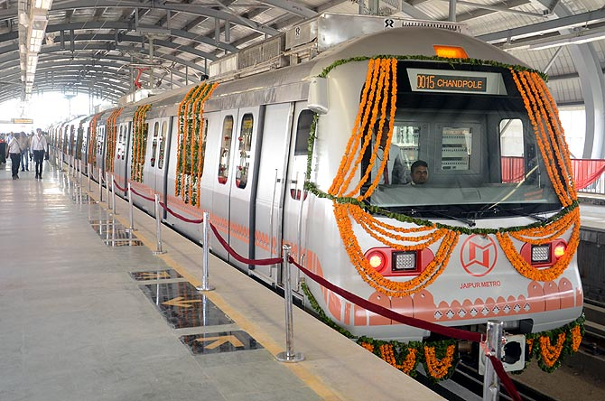
The end

